Slide 1
Running
Up The
Score
Tech
Titans
NFL Running Back Salary and Production Forecasting

Slide 2

Team
Members
Gabriel Galley
Tony Lockhart
Asa Adomatis
Dexter Johnson
Gerardo Castanos
Gabriel Jean-jumeau

Slide 3
TABLE OF CONTENTS
01
OVERVIEW
02
THE DATA
03
CONCLUSIONS
Our questions, some key terms, and our datasets
TT
Visualizations and interpretations
Answers, and more questions?

Slide 4
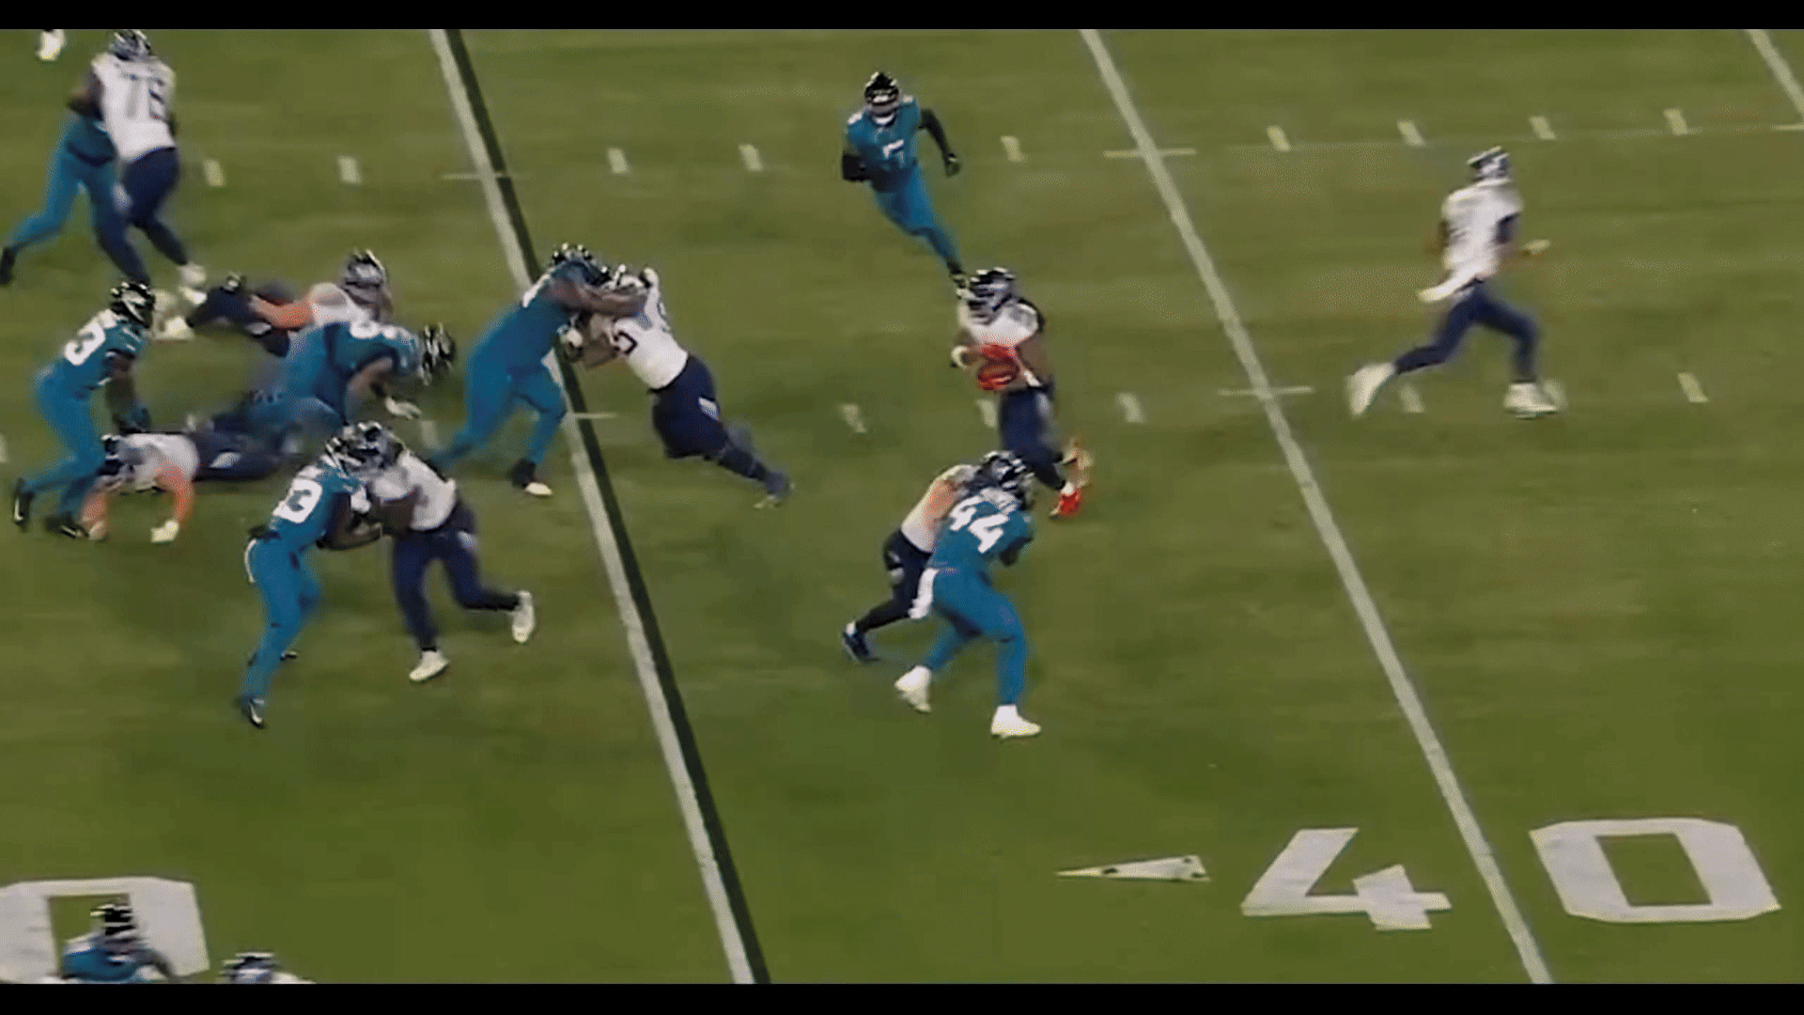
Overview
An Intro to the NFL, for the uninitiated
Notes:
This is the start of section one, where we introduce our topic, questions, key terms, and general outline

Slide 5
National Football League
NFL has 32 teams of 53 players, 17 games per season
That’s ~30,000 player-games per season
Data ripe for the analysis!
Of 19 positions per team, we’ll focus on running backs

Slide 6
QUICK KEY TERMS
CAP HIT
(SALARY CAP)
PRODUCTION
RUNNING
BACKS
In this study, we will define a player’s production as rushing yards/attempts per season, a sum of the total yards/attempts by a particular player throughout a single season. We will also use Touchdowns as a metric for production in one instance.
Cap Hit refers to the total salary penalty of a specific player towards their team’s yearly total Salary Cap, usually equivalent to their total pay
We took a closer look at one position in particular: running backs, those who carry the ball in hand - the bell cows of their teams

Slide 7
What are we trying to learn?
What are the critical factors that most effectively determine running back cap hit?
What is the correlation between player position and cap hit?
Any significant outliers?
How does a running back’s production correlate with their cap hit?
Are there any correlations present between cap hit and age/years of experience?

Slide 8
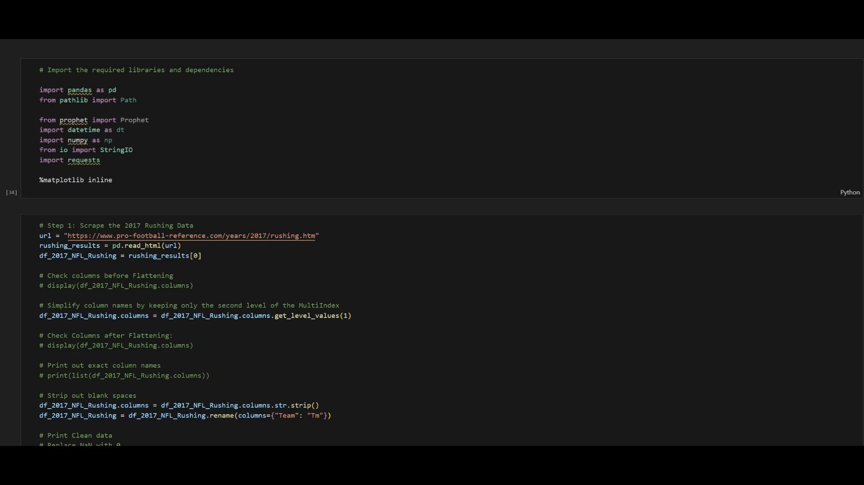
Our Datasets
NFL Player Data
NFL Salary Data
Contextualized salary cap data and cap hit %, both provided by Kaggle.com
Basic stats, career stats, and game logs provided by Pro Football Reference (17-18), NFL Stats (17-19), and Stathead (17-18)
Notes:
-Emphasize 2017-2019 years used!!!

Slide 9
The Merge
Our Master List
We took the data from both player data and salary CSVs, scrubbed them, and combined them to make our final dataset

Slide 10
Data on the
RUN
Notes:
Here is where we begin introducing our visualizations

Slide 11
Please hold for a brief demo

Slide 12
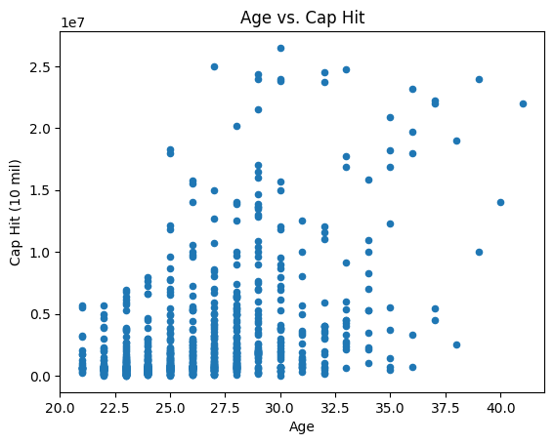
Age v. Salary
Notes:
**OUTLIERS
Does a Running Backs age have an impact on their salary? By looking at the distribution of the points on the plot, you can get an idea of whether there is a correlation between these two factors.
Most of the dots are for people aged 22 to 40, which means most of the data is about this age group. The money (Cap Hit) varies a lot-- some earn less, while a few earn much more. After the age of 30, there are fewer dots, meaning fewer people are being tracked or earning significant money in this chart. In simple terms, it shows how age relates to earning , and most of the big money seems to happen in the younger age range.
The data display is a scatter plot that aims to visualize the relationship between the age of an NFL running back and their salary cap hit. Each point on the plot represents a single running back.
Purpose: The display intends to show whether there is a correlation or pattern between these two variables – age and cap hit (salary).
Interpretation:
If points are clustered together in a clear pattern (e.g., a line or curve), it suggests a strong correlation between age and salary.
For example, an upward trend would suggest that older running backs tend to have higher salaries.
If points are scattered randomly without any noticeable pattern, it suggests a weak or no correlation between age and salary, meaning age may not be a strong predictor of a running back's salary.
In essence, the scatter plot provides a quick visual summary of whether or not there is a relationship between a running back's age and their salary in the NFL using the data collected in the dataset (edited)

Slide 13
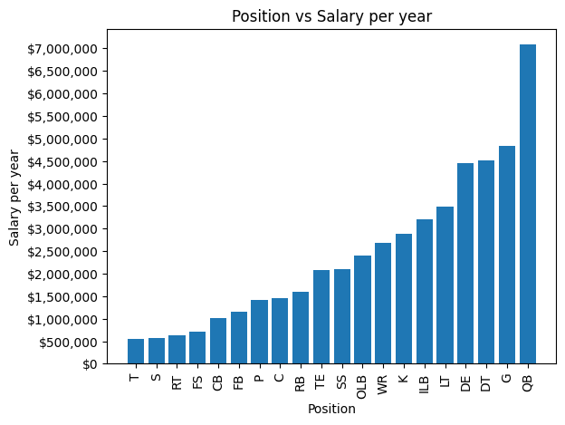
Position v. Salary
Notes:
Looking at NFL position salaries, running backs (RB) earn approximately $1.5 million per year, placing them in the lower third of the pay scale. This relatively modest compensation compared to quarterbacks at $7 million, or guards and defensive ends at $4-5 million, raises an interesting question: how does actual performance impact RB salaries? This leads us to our next analysis examining the relationship between touchdowns and salary.

Slide 14
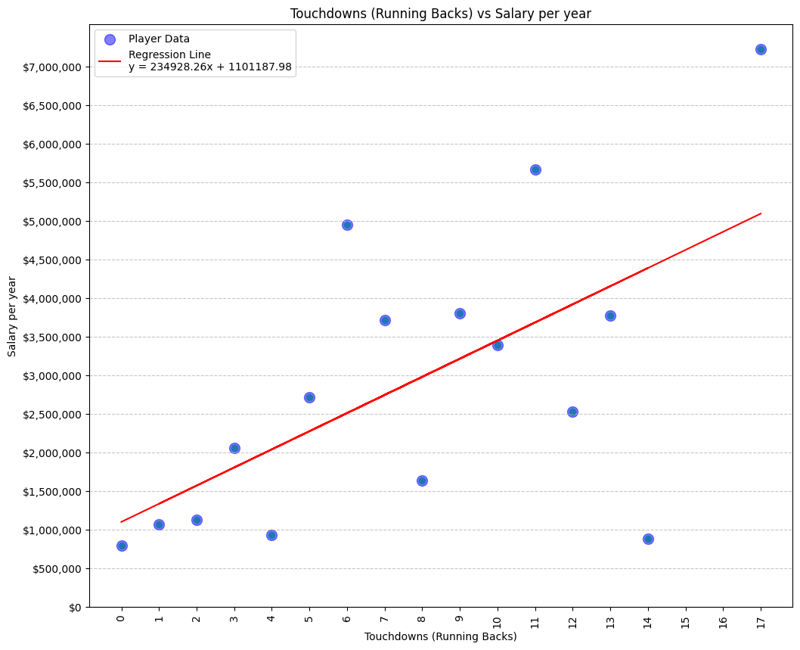
Touchdowns
v. Salary
Notes:
The data is filtered to show only running backs.
Overall R-value: 0.6155, Showing a positive correlation between increase in touchdown resulting in increased salary.
Overall R-squared value: 0.3788
Overall P-value: 0.0112
Our analysis of running back salaries reveals a moderate positive correlation with touchdown performance, shown by an R-value of 0.6155. While touchdowns do influence salary they only explain about 38% of salary variations. This statistically significant relationship (p-value 0.0112) suggests that while scoring ability matters, teams consider multiple factors beyond touchdowns when determining running back salary.

Slide 15
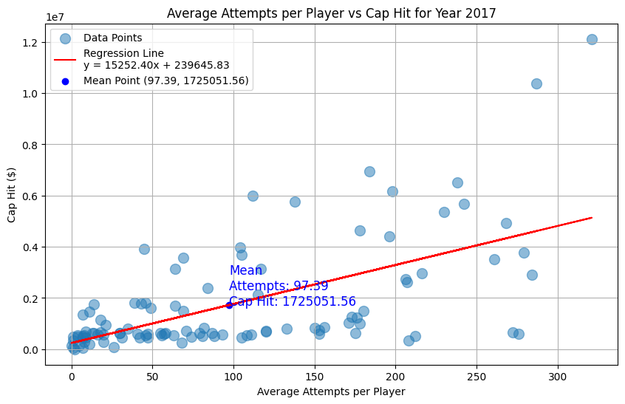
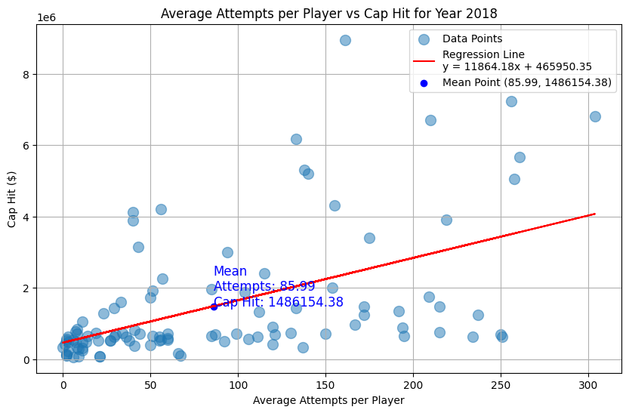
2017/18 Avg. Rush Attempts
v. Salary
Notes:
Running back rushing attempts and salary data are grouped by Year, Player, and Position to calculate average Rushing Attempts and Cap Hit per player for the season. The annotation near the regression line highlights the mean rushing attempts and mean cap hit for all players. The regression line, y = mx + b , represents the best linear fit and predicts Cap Hit based on Rushing Attempts.
2017 Analysis:
r-value: 0.6120 indicates a moderate positive correlation.
R-squared: 0.3746 shows 37.46% of the variance in “Cap Hit” is explained by “Rushing Attempts.”
p-value: 0.0000 confirms the relationship is statistically significant.
2018 Analysis:
r-value: 0.5233 indicates a moderate positive correlation.
R-squared: 0.2739 shows 27.39% of the variance in “Cap Hit” is explained by “Rushing Attempts.”
p-value: 0.0000 confirms the relationship is statistically significant.

Slide 16
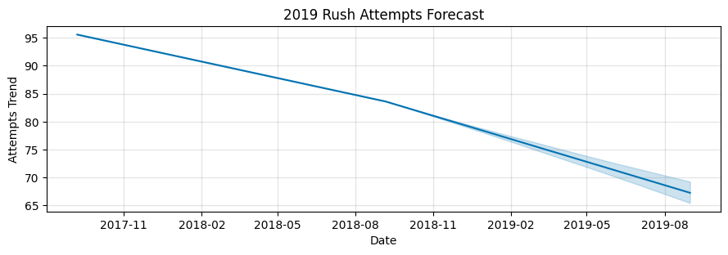
Predicted Rush Attempts over Time
Notes:
Using profit, we are forecasting rush attempts in 2019 for which we do not have data using the data we have for 2017-2018
The forecast indicates a negative trend of about (-10 rAttmpts/yr)
(Tony Added) By inputting 2017 and 2018 rushing data into the Prophet model, we generated a forecast for 2019 rushing attempts. The trend shows a steady decline from 2017 to 2019, with 2019 expected to see further decreases compared to 2018. In 2017, the mean rushing attempts were 97.39, dropping to 85.99 in 2018.

Slide 17
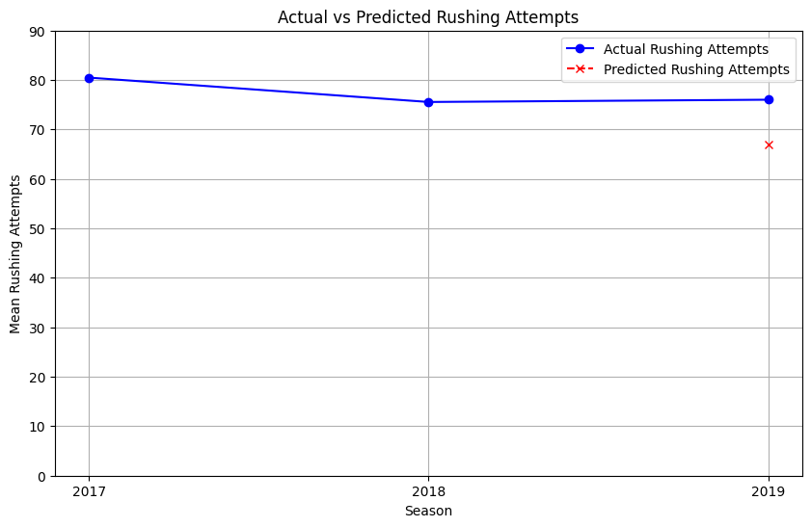
Actual Vs Predicted Rush Attempts
Notes:
The Prophet model predicted a decline in rushing attempts for 2019, but actual NFL data shows a slight increase, suggesting stabilization. Predictions based on past trends can be inaccurate due to shifting team strategies. Additionally, discrepancies between the data used for the prediction (Kaggle and Pro Football Reference) and official NFL stats show a larger spread in rushing attempts between 2017-2018, which may have biased the prediction.

Slide 18
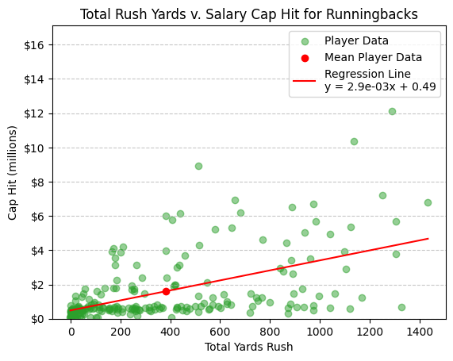
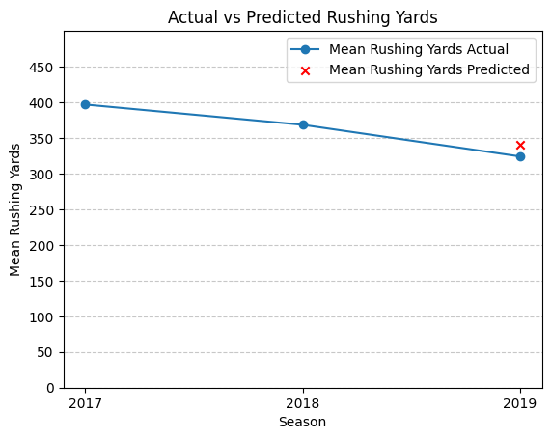
Rush Yards over Time
Notes:
The regression of Total Rush Yards v. Salary Cap Hit revealed an r-value of 0.5325 meaning the total rush yards of NFL running backs has a moderate positive correlation to their cap hit. The regression line demonstrates this relationship. Its slope of 0.0029 means that for about every yard run, a running back earns $2900 dollars on their salary. You can also see the regression line has a y-intercept of 0.49 meaning it predicts a starting pay of $490,000 while in 2018 the starting pay was actually $480,000 for rookies.
In the second image, we demonstrate prophets use to predict mean rushing yards between NFL seasons. Using the 2017 and 2018 data, prophet predicted a decrease in mean rushing yards by around 18, while in actuality the mean decreased by around 44 yards.

Slide 19
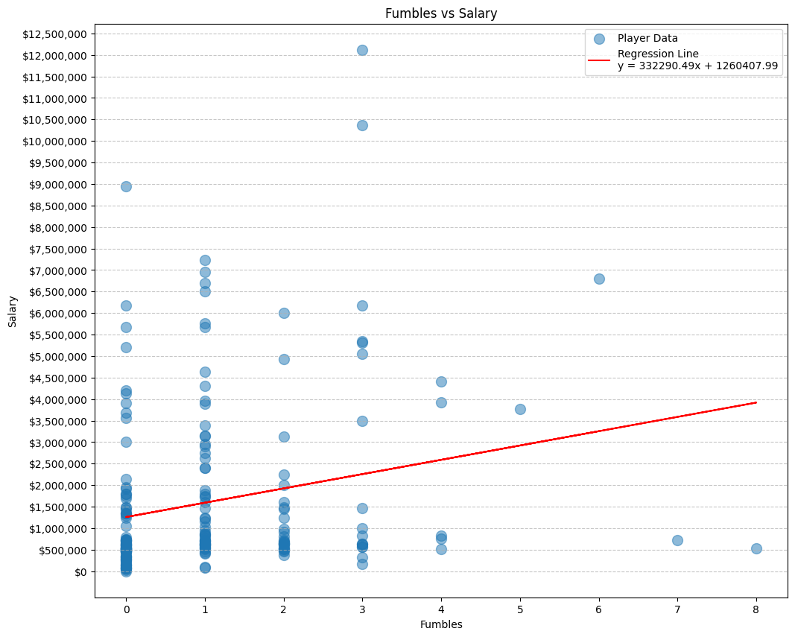
Fumbles v. Salary
TT
Notes:
Overall R-value: 0.2216
Overall R-squared value: 0.0491
Overall P-value: 0.0014
Analyzing the relationship between fumbles and salary reveals a weak correlation of 0.22, with only 5% of salary variation explained by fumbles. Despite reaching statistical significance, the scattered plot and low R-squared value suggest that fumbles have minimal impact on a player's salary.

Slide 20
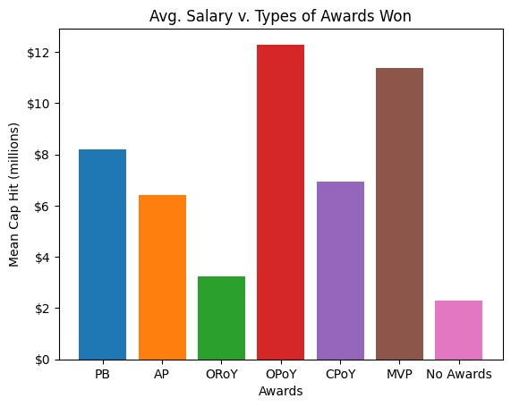
Awards Received v. Salary
PB - Pro Bowl
AP - All-Pro
ORoY - Offensive Rookie of the Year
OPoY - Offensive Player of the Year
CPoY - Comeback Player of the Year
MVP - Most Valuable Player
No Awards - No Awards Received
Notes:
By comparison, players with awards have a higher cap hit than players without with greatest cap hit given to players OPoY (offensive player of the year) and MVP.

Slide 21
Running the
Numbers
02

Slide 22
Which
Factors impact
Cap Hit the most…
Fumbles
Position
Touchdowns
Stats
Age
Awards
Notes:
Touchdowns by way of R-value of over 6.15
****There is so much that strays into the intangible that can determine a player’s cap hit as significantly as the factors as we have explored, including things like: attitude, criminal record, effort level, elevated liability for injury, etc.
-Fumbles presented a meek correlation with salary, owing to the bias present with increased rushing attempts translating to increased fumbles regardless of a player’s overall quality
-Position presented an insight into who makes the most money, which manifests as a clean upwards trend with the only significant outlier being quarterbacks
-Touchdowns presented a fairly strong positive correlation with a couple of outliers that could be attributed to rookies scoring touchdowns while on low-salary rookie contracts
-Given that rookies are often drafted to fill the role of “bell cow runningback,” it is no surprise that the correlation between rushing yards/rushing attempts and salary is rather weak. If we filtered for those no longer on rookie contracts, I wouldn’t be surprised if the regression would fit quite a bit tighter. However, since the NFL operates within strict salary guidelines, it is no surprise that teams take advantage of the cheap production of rookie running backs
-The correlation between age and cap hit results in the vague shape of a normal distribution, with outliers to the right of the mean suggestive of unusual outperformers skewing the aging end of the data northwards. This suggests several concurrent trends that obfuscate each other when combined into one visualization, but when viewed simultaneously represent a moderate positive correlation
-The correlation between awards and cap hit, one of the more obvious depictions of correlation in our study, shows that players receiving awards earn more than those who do not. MVPs and Offensive Players of the Year, often Quarterbacks, have the highest associated mean salary cap hit

Slide 23
Where
Do We Go
From Here?
Other positions
Wider range of years

Slide 24
THANKS!
Q&A time!
Tech
Titans
Links:
Github Repo
Kaggle Salary Data
2017 Merged Rushing + Salary Dataset
2018 Merged Rushing + Salary Dataset
2017 RB positions
2018 RB positions
2019 RB positions
2017 NFL stats
2018 NFL stats
2019 NFL stats

